Slide 1



PYTHON REINFORCEMENT PROJECT – 1
PRESENTED BY
ABIDEV

Slide 2
NETFLIX DATA ANALYSIS

Slide 3
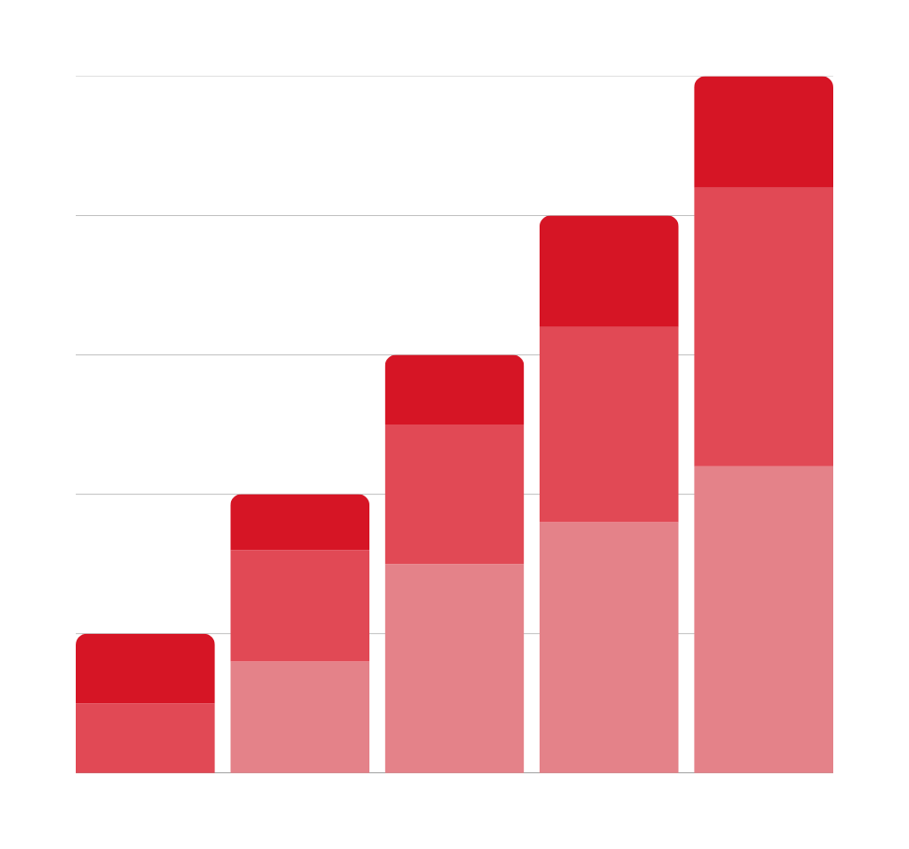
AIM
•TO CLEAN, PREPROCESS, AND ANALYZE NETFLIX DATASET TO DERIVE MEANINGFUL INSIGHTS ABOUT ITS CONTENT DISTRIBUTION, TRENDS, AND PATTERNS.

Slide 4
OBJECTIVES :
•Clean and standardize dataset
• Handle missing values
• Convert and extract date/time features
• Analyze duration and type of content
• Visualize trends and generate insights

Slide 5
KEY INSIGHTS
• Type Distribution: Percentage of Movies vs TV Shows
• Most Common Ratings: e.g., TV-MA, TV-14
• Content Trend: Number of titles added per year
• Top Countries: e.g., United States, India, UK
• Duration Analysis: Average movie duration, typical seasons for TV Shows

Slide 6
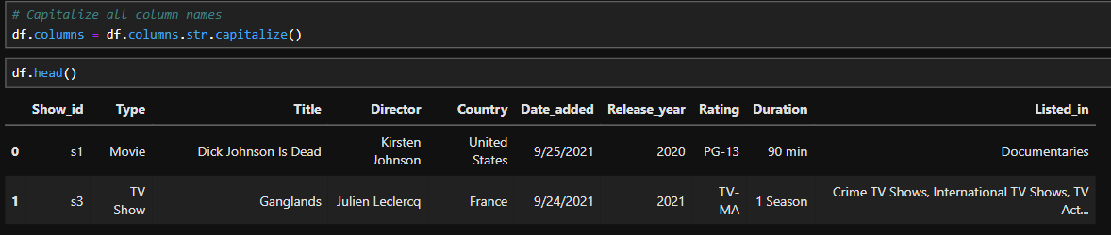
DATA CLEANING
THE COLUMN IS IN LOWER CASE, USING COLUMNS . CAPTIALIZE THE COLUMNS TITLE IS CAPTILIZED

Slide 7
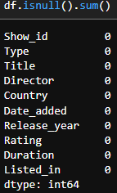
DATA CLEANING
BY USING ISNULL FUNCTION WE IDENDIFIED THERE IS NO NULL VALUE
SO THE DATA IS CLEAN

Slide 8
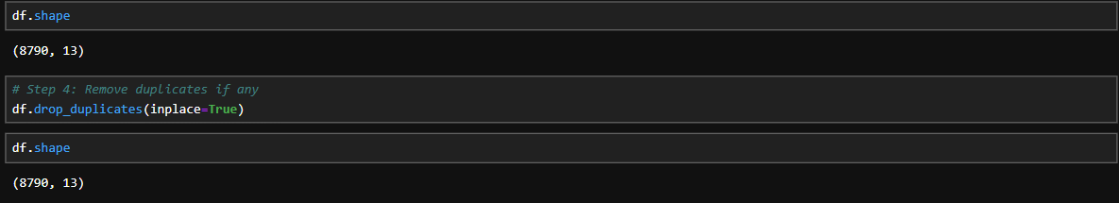
DATA CLEANING
BY USING DROP DUPLICATES THE DUPLICATE DATA IS REMOVED
BUT THERE IS NO DUPLICATE DATA .WE CHECKED BY USING SHAPE FUNCTION BEFORE AND AFTER DROP DUPLICATE FUNCTION

Slide 9
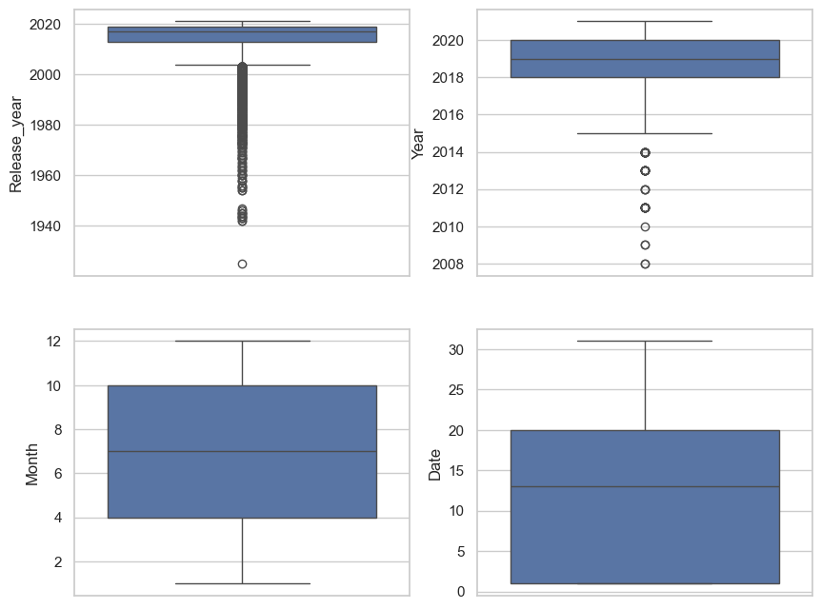
BOXPLOT:
A boxplot is a graphical representation of the distribution of dataset. It is useful for spotting outlier, uderstanding spread, and comparing medians across differnt groups

Slide 10
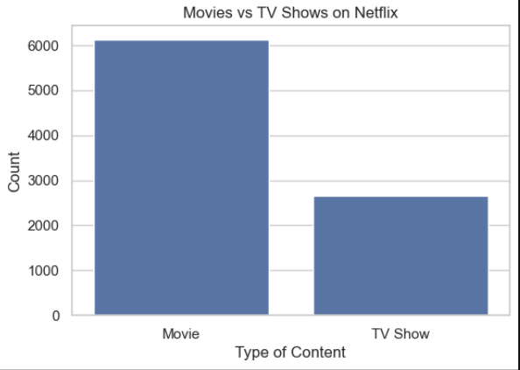
Movies dominate Netflix’s library → The number of movies is more than double the number of TV shows.
TV Shows are fewer but growing → While movies still lead, Netflix has been increasing its investment in original TV shows in recent years.
User preference reflection → This imbalance may reflect Netflix’s strategy to offer a wide variety of films to attract global audiences.
TV Shows are strategic for engagement → Though smaller in number, TV shows often keep users subscribed longer because of multiple episodes/seasons.
Overall insight → Netflix is primarily a movie-heavy platform, but TV shows play a crucial role in retaining subscribers and driving long-term engagement.
COUNTPLOT FOR TYPE COLUMN

Slide 11
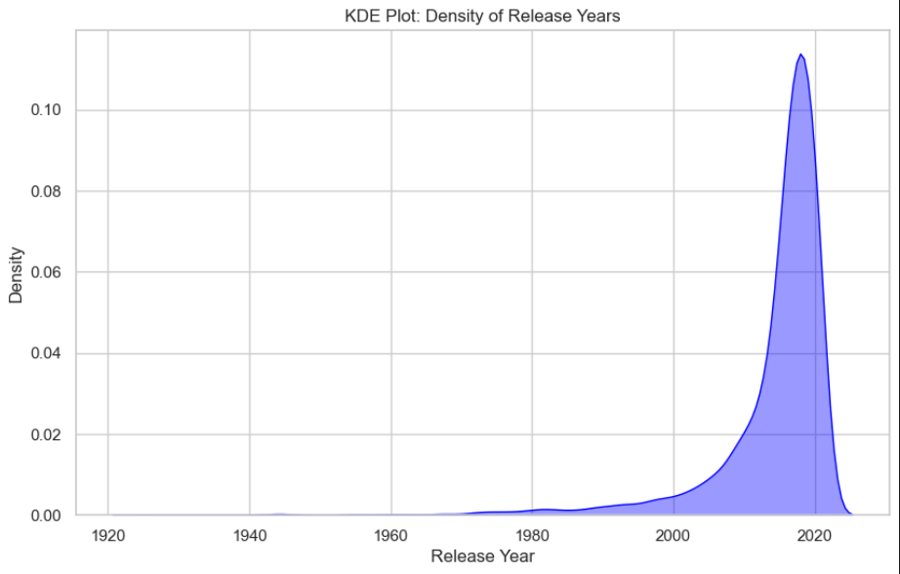
Very few titles before 1980 – Netflix’s library includes only a handful of very old/classic movies.
Gradual rise after 1990s – Content availability slowly increases from the 1990s onward.
Sharp growth after 2000 – The density starts climbing rapidly after 2000, reflecting the digital and streaming boom.
Peak around 2015–2020 – Most Netflix titles are concentrated in this period, showing the platform’s aggressive expansion.
Slight decline post-2020 – The density drops after 2020, possibly due to the COVID-19 pandemic affecting production.
KED PLOT FOR RELEASE YEAR

Slide 12
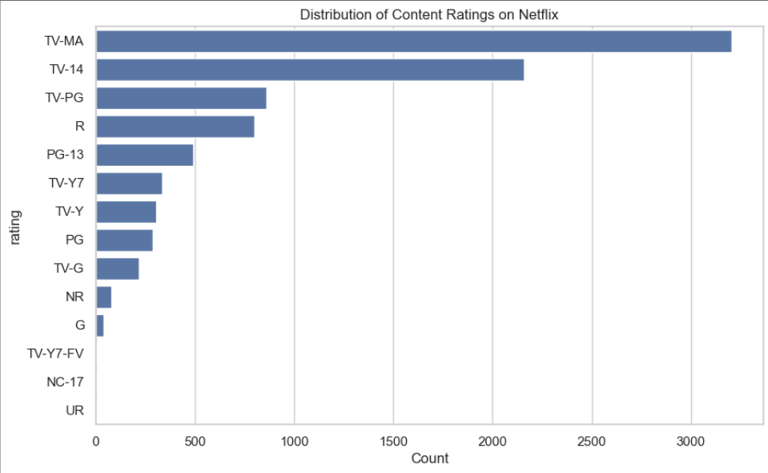
TV-MA (Mature Audience) is the most common rating with over 3,000 titles, meaning Netflix has a strong focus on adult-oriented content.
TV-14 comes second, showing a large share of content suitable for teenagers and young adults.
TV-PG and R-rated titles form the next tier, catering to family audiences and mature movie watchers.
Ratings like TV-Y, TV-Y7, PG, and TV-G are much fewer, indicating limited children’s content compared to adult and teen content.
Rare ratings such as NC-17, UR, and G are almost negligible, suggesting Netflix avoids extremely restricted or overly niche categories.
COUNTPLOT FOR RATING

Slide 13
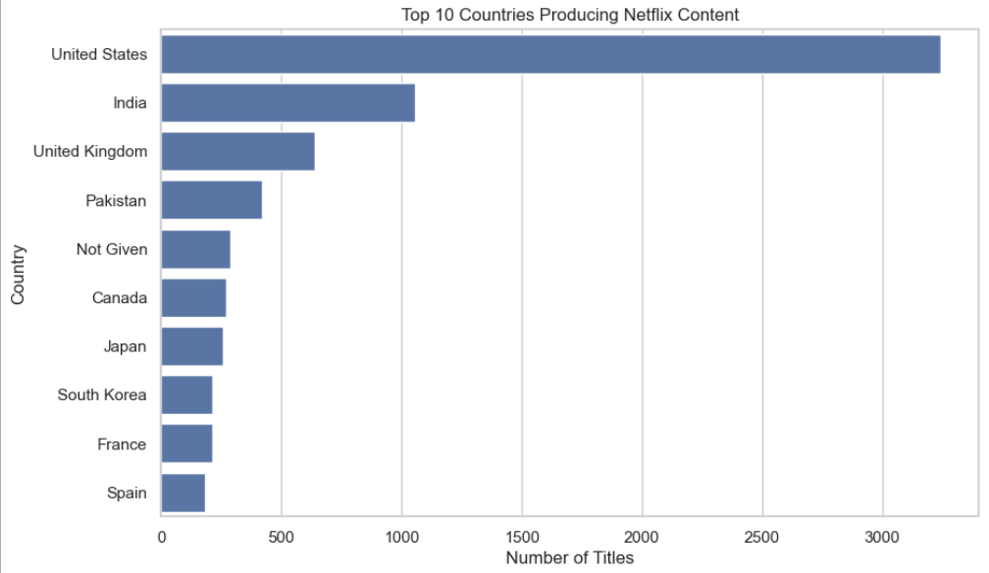
BIVARIATE ANALYSE
United States dominates with the highest number of Netflix titles (by a big margin).
India is in second place, showing its strong role in Netflix’s international expansion.
United Kingdom follows, contributing a significant number of titles.
Countries like Pakistan, Canada, Japan, South Korea, France, and Spain also appear, but with much smaller contributions compared to the US.
The presence of “Not Given” indicates missing country data in the dataset.
BARPLOT FOR TOP COUNTEIES

Slide 14
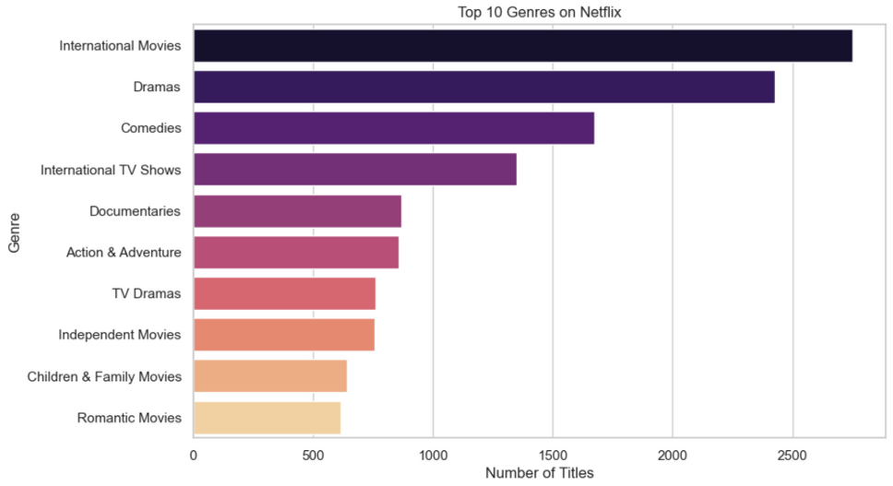
BARPLOT FOR GENRE COUNTS
International Movies dominate, showing Netflix’s strong focus on global/local content to appeal to different regions.
Dramas and Comedies are next — these are evergreen genres with wide appeal.
International TV Shows also rank high, reinforcing Netflix’s strategy of diversifying content beyond Hollywood.
Documentaries have a strong presence, reflecting growing interest in real-life stories.
Genres like Action & Adventure, TV Dramas, Independent Movies, Children & Family Movies, and Romantic Movies are present but comparatively smaller.

Slide 15
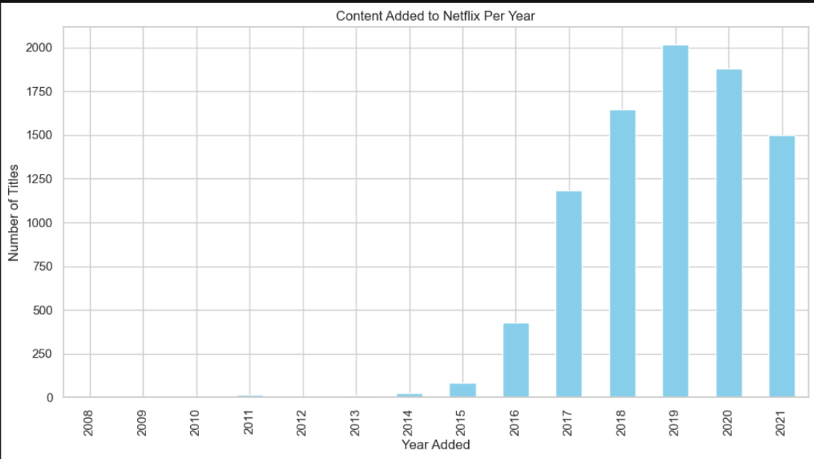
Sharp Growth After 2015
Netflix added very little content before 2014.
From 2015 onwards, there’s a sharp rise, reflecting Netflix’s global expansion.
Peak Years
Around 2017–2019, the number of new titles surged, peaking close to 2000 titles per year.
This was the period when Netflix heavily invested in original content and international licensing.
Slight Decline After 2020
After 2019, the trend shows a slight decline in content addition.
Possible reasons:
Market saturation.
COVID-19 pandemic affecting production.
Netflix focusing on quality originals rather than bulk additions.
3.HISTPLOT FOR CONTENT ADDED TO NETFLIX PER YEAR

Slide 16
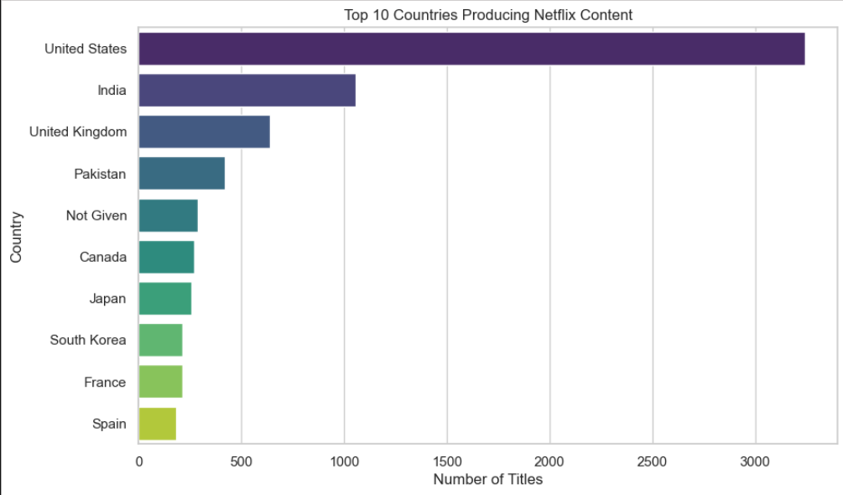
3. TOP 10 COUNTRIES PRODUCING CONTENT
United States clearly dominates, producing the largest share of Netflix content.
India comes second, highlighting Netflix’s strong push into the Indian entertainment market.
United Kingdom is third, reflecting its well-established TV and film industry.
Countries like Pakistan, Canada, Japan, South Korea, France, and Spain also contribute, but in smaller volumes.
The presence of “Not Given” again shows some missing metadata in the dataset.

Slide 17
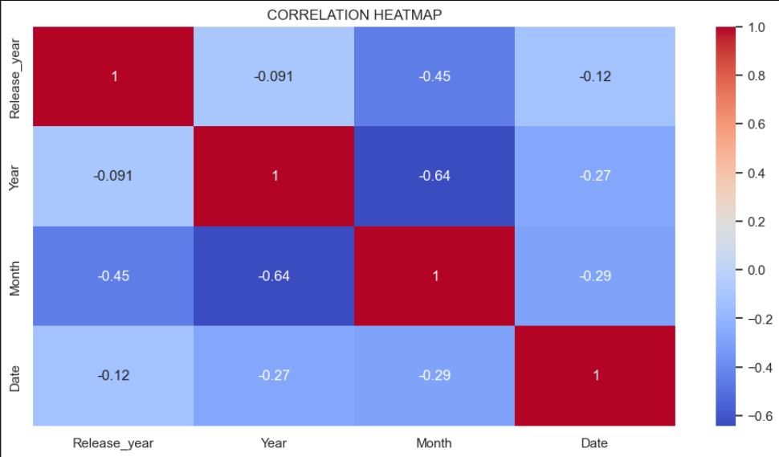
Strong Negative Correlation (−0.64) between Year and Month
Suggests that as the dataset spans across years, the monthly distribution of added titles changes.
Likely reflects Netflix’s uneven release strategy (not all months are equally active).
Moderate Negative Correlation (−0.45) between Release Year and Month
Older releases may have been added in bulk during specific months.
Recent releases follow a more regular pattern.
Low Correlation with Date
The exact day (date) of addition doesn’t show strong relationships with year or month.
This means Netflix releases content on various days without a fixed trend.
Release Year vs Year (−0.091)
Very weak relationship, showing that the year of release is not tightly linked to the year content was added to Netflix.
Example: Old movies/shows being added much later.
HEATMAP

Slide 18
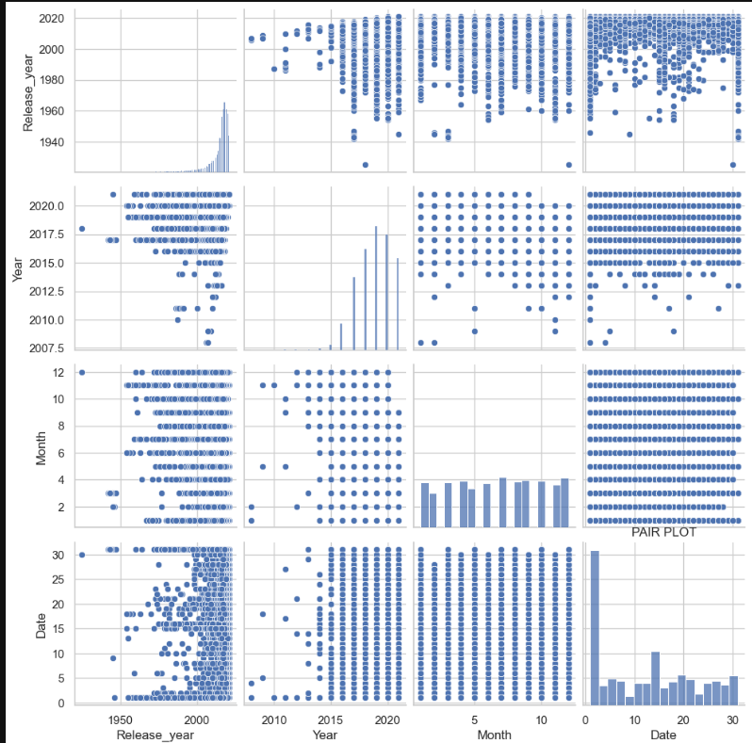
Release Year vs Year
Shows that Netflix adds both new and old titles.
Many older movies/shows (from 1950s–2000s) were added in recent years, not just when they were released.
Month vs Year
Certain months have more additions, pointing to seasonal trends (holiday periods, mid-year boosts).
Date distribution
Titles are spread across different dates with no strict pattern → Netflix doesn’t stick to a single release day.
Diagonal histograms
Release Year is skewed towards 2000 onwards → majority of Netflix content is modern.
Addition Year (Year) shows a sharp rise after 2015 → aligns with Netflix’s global expansion.
PAIR PLOT

Slide 19
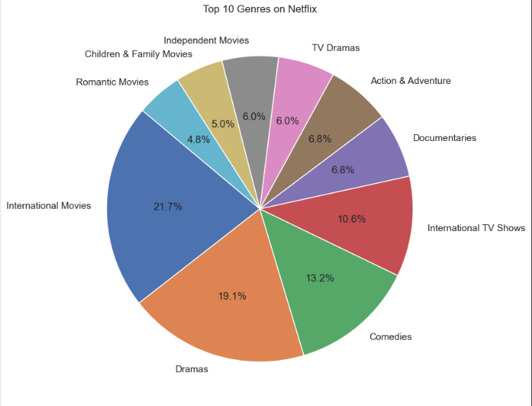
International Movies (21.7%) and Dramas (19.1%) dominate the Netflix catalog → Netflix is heavily focused on global and story-driven content.
Comedies (13.2%) and International TV Shows (10.6%) also take a big share → reflecting the platform’s push for light entertainment and regional series.
Documentaries (6.8%) and Action & Adventure (6.8%) highlight Netflix’s effort to balance between fun content and knowledge-based/real stories.
Smaller shares go to TV Dramas (6.0%), Independent Movies (6.0%), Children & Family Movies (5.0%), and Romantic Movies (4.8%) → showing niche but important audiences.
PIECHART

Slide 20
OVERALL INSIGHTS
Netflix is movie-heavy but has a growing number of series.
Recent years (post-2015) brought a big jump in content.
Regional expansion (India, UK, Canada) plays a huge role.
Genres and ratings distribution highlight Netflix’s focus on global and adult-oriented content.

Slide 21
THANK YOU VERY MUCH!

